Slide 1
Chemistry
Atoms, Compounds and Mixtures
LabRat Scientific
© 2018
COMPOUND

Slide 2
Atom Basics
The center of the atom is called the Nucleus.
The mass of the atom comes from the Protons and Neutrons.
E
N
P
Electrons are usually considered massless
This is a “simplified” picture…
The electrons are not really orbiting the nucleus in circles, they are zipping around in a cloud-like manner…
P
N
E
Number of Neutrons does not have to equal the number of Protons
Atoms can share electrons. When this happens, a compound is created (e.g. H₂O)
Neutrons
Protons
Electrons – source of the atoms electrical charge. No mass

Slide 3
Atom Basics
The number of Protons defines the element
Atoms have a neutral charge and thus the Protons (+ charge) are equal in number to Electrons (- charge).
However, atoms can have electrons stripped away or added. When this happens they are known as IONS
The element stays the same (due to the fact that the number of Protons stays the same)
The mass of an atom comes from the Neutrons and Protons
Electrons can be considered massless
The number of neutrons does not have to match the number of protons
The Atomic Number comes from the number of Protons in an atom
The number of protons defines the element

Slide 4
Compounds versus Mixtures
Or
Atoms of Element #1
Atoms of Element #2
MIXTURE
COMPOUND
In a mixture, the atoms do not chemically combine with one another. An example is mixing salt and pepper – you can still see the separate white salt and the black pepper…
In a compound, the atoms chemically combine (share electrons) and a new substance is created. Hydrogen and Oxygen chemically combine to produce water…

Slide 5
A Basic Compound
These two atoms are sharing an electron. However, its not always the same electron…
E
N
P
P
E
N
E
N
P
P
N
N
P
These atoms are “chemically” combined and thus form a “compound”…
E

Slide 6
Atom Bonding
Atoms can be bound together in two ways:
Covalent Bond = Shared electrons
Ionic Bond = One atom steals an electron from another. Both atoms then have an electrical charge; one being positive and one being negative. These opposite charges attract… Ionic bonding only occurs with certain atoms.

Slide 7
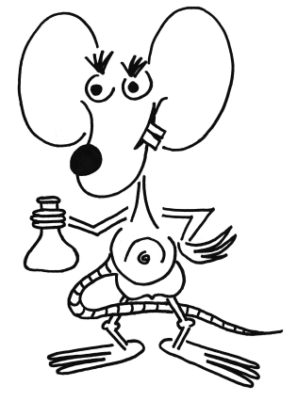
Questions?

